Slide 1



SAVEETHA SCHOOL OF ENGINEERING
SAVEETHA INSTITUTE OF MEDICAL AND TECHNICAL SCIENCES
CSA0697 - DESIGN AND ANALYSIS OF ALGORITHM FOR LOWER BOUND THEORY
Bank Account Details Management System Using Binary Search
FACULTY NAME: Dr.Gnana Soundari
By,
NAME : B. Revanth Harsha Vardhan
REG.NO: 192210076

Slide 2


Importance of Efficient Data Management
1
Quick Access
2
Accurate Records
Fast retrieval of account information is essential for seamless operations.
Ensuring accurate and up-to-date data is vital for maintaining customer trust.
3
Improved Efficiency
4
Secure Transactions
Streamlining data management processes reduces errors and saves time.
Efficient management guarantees secure and reliable account transactions.

Slide 3
Overview of Binary Search Algorithm
Divide and Conquer
Efficient Search
Logarithmic Complexity
Binary search systematically divides a sorted dataset in half.
If the target is greater, it searches the right half.
This approach significantly reduces search time, especially for large datasets.
It compares the target value with the middle element.
If the target is smaller, it searches the left half.

Slide 4

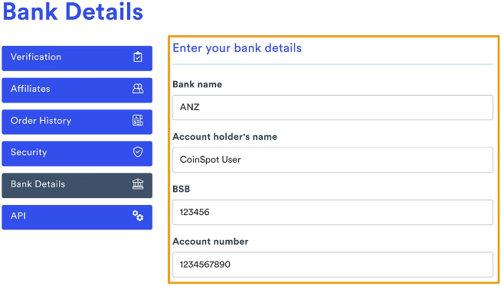



Implementation of Binary Search for Account Details
Sorting Accounts
First, we need to sort the account details by a unique identifier like account number.
Target Account
The user provides the target account number they want to find.
Binary Search
The system applies binary search to locate the account quickly.

Slide 5

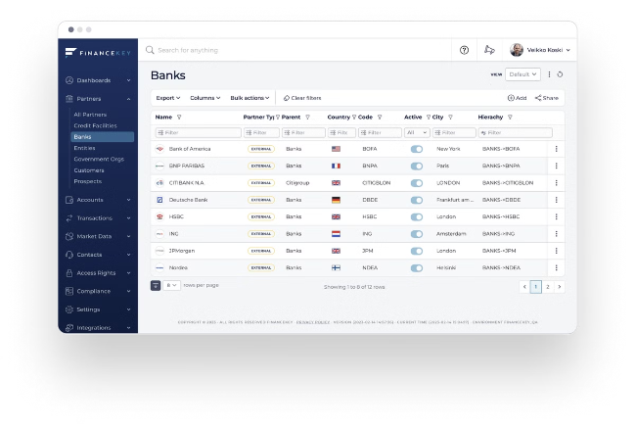
Benefits of Binary Search in Account Management
Faster Search Times
Reduced time to retrieve account data, improving user experience.
Scalability
Handles large datasets efficiently, supporting growth in customer base.
Improved Accuracy
Reduces the risk of errors in finding account information.

Slide 6


Handling Large Datasets with Binary Search
Efficient Indexing
Data Partitioning
Parallel Processing
Maintaining a sorted index of account details facilitates quick searches.
Dividing the data into smaller, manageable chunks speeds up search operations.
Utilizing multiple processors can significantly enhance search speed for extensive datasets.

Slide 7


Scalability and Performance Considerations
1
Database Optimization
Optimizing the database structure and queries improves performance.
2
Caching Mechanisms
Storing frequently accessed account data in cache enhances response times.
3
Load Balancing
Distributing requests across multiple servers minimizes server overload.

Slide 8


Conclusion and Future Enhancements
Binary search significantly enhances the efficiency of bank account details management systems.
Future enhancements might include implementing advanced search algorithms, incorporating real-time data updates, and enhancing security measures.

